Slide 1
ARM-FINAL PROJECT

Slide 2
01
Table of Contents
02
03
04
Project Idea
Brief description of the project idea
LCD
Usage in the project and how it works
Buttons & Leds
Description and usage in the project
LED-MATRIX
What is the led-matrix and usage in the project
TFT
05
What is the TFT and usage in the project

Slide 3
01
Project Idea

Slide 4

Project Idea
Your logo
Our project revolves around implementing a TV-Show Selector Program using two microcontrollers, ARM, and the drivers we've developed for various hardware components. These components include LED matrix displays, TFT screens, LCDs, LEDs, and buttons.

Slide 5
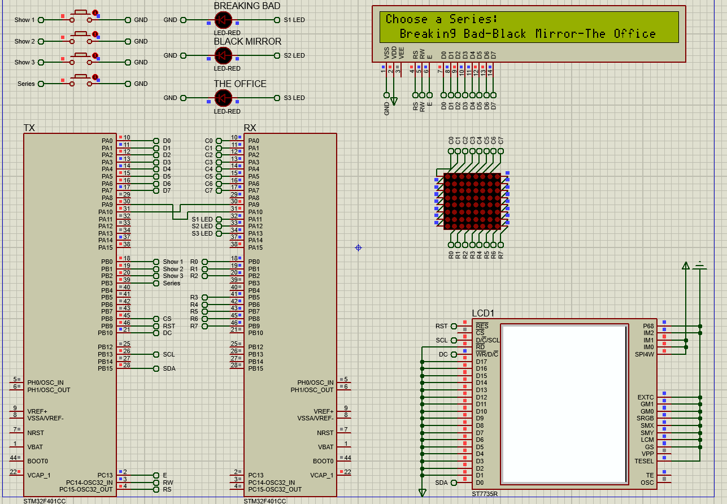
Project Overview
TV-Show Selector Program Features:
Intuitive Navigation: Four buttons allow easy selection of shows.
Visual Feedback: Show names appear on LCD and LED matrix upon selection.
Interactive Indication: LED lights up to highlight the chosen show.
Immersive Experience: TFT screen displays show photos for enhanced engagement.

Slide 6
02
LCD

Slide 7
LCD
Usage of the LCD Screen:
Show Selection Display: Upon selecting a show using the buttons, the LCD screen dynamically updates to display the name of the chosen show. This feature provides users with immediate feedback, confirming their selection and aiding in navigation.
Home Menu Interface: Additionally, the LCD screen serves as the interface for the home menu. Users can navigate through different options and menus using the buttons, and the LCD screen displays these options in a clear and organized manner. This allows users to easily access various functionalities of the TV-Show Selector Program.

Slide 8
LCD-Drivers
GPIO:GPIO pins on microcontrollers serve as versatile interfaces that can be configured as either inputs or outputs. They are used to connect and communicate with various external devices, such as sensors, buttons, LEDs, and displays.
RCC: RCC is a peripheral found in many microcontrollers, responsible for controlling the clock system. It manages clock sources, clock distribution, and clock gating for various peripherals and the CPU.
STK :The clock signal is essential for synchronizing the operations of the microcontroller and its peripherals. It provides timing information for various tasks, including data processing, communication, and peripheral control.
LCD:The LCD driver initializes and controls the liquid crystal display (LCD) module, enabling the microcontroller to send commands and data to the display for showing text, numbers, and custom characters, and providing functions for clearing the screen and setting cursor position.

Slide 9
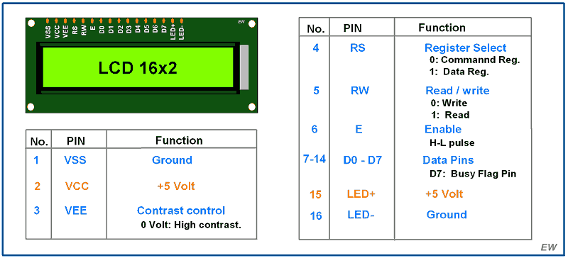
LCD
VSS: Ground VDD: Power Supply (+5V)
V0: Contrast Adjustment RS: Register Select
R/W: Read/Write (usually grounded) E: Enable
D0-D7: Data Lines (8-bit mode) D4-D7: Data Lines (4-bit mode)
A: Anode (backlight) K: Cathode (backlight)

Slide 10
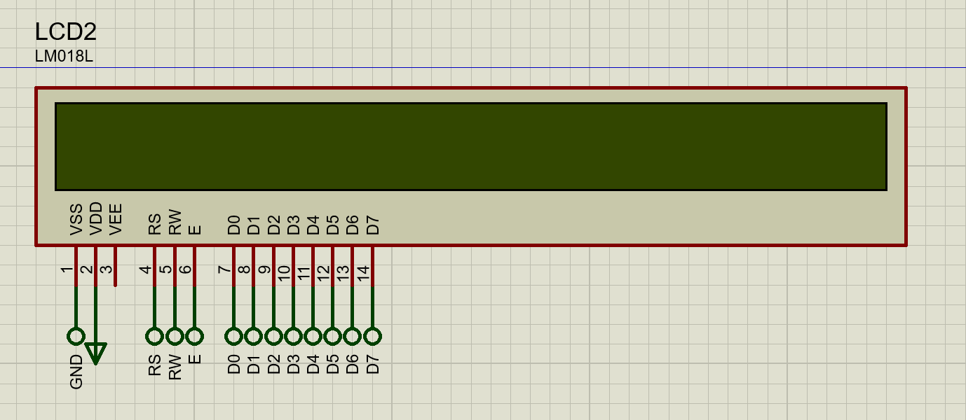
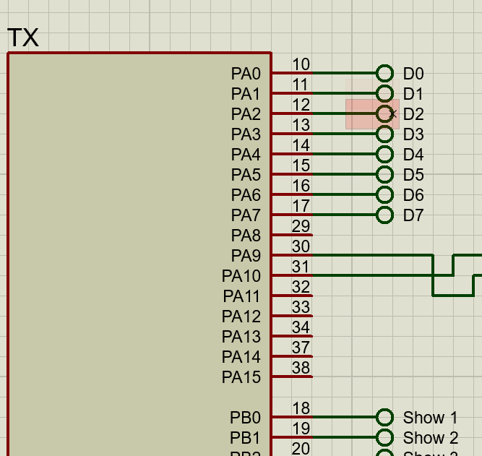
LCD-Connection
LCD Data Lines:
Port A, Pins 0 to 7 are used for connecting the data lines of the LCD module. These pins facilitate bi-directional communication between the microcontroller and the LCD, allowing for the transmission of characters and commands to the display.

Slide 11
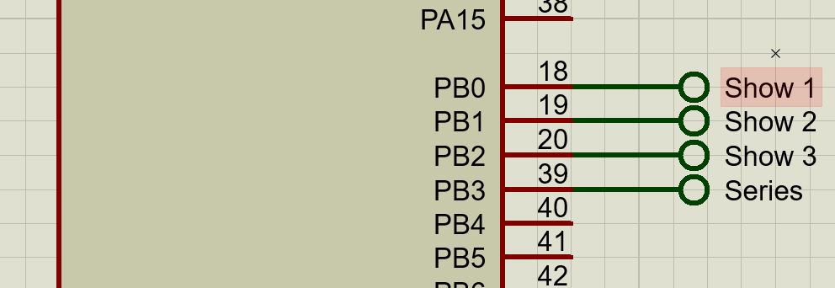
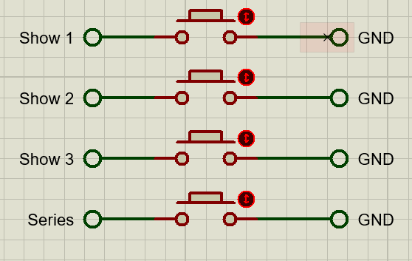
LCD-Connection
Button Inputs:
Four buttons are connected to Port B, Pins 0 to 3 on the microcontroller. These buttons are configured as digital inputs and allow users to navigate through available show options and make selections within the TV-Show Selector Program.

Slide 12
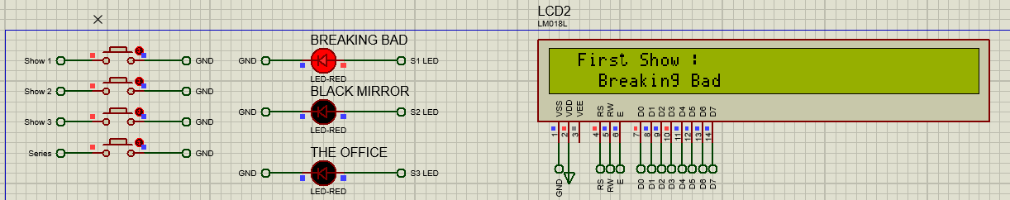
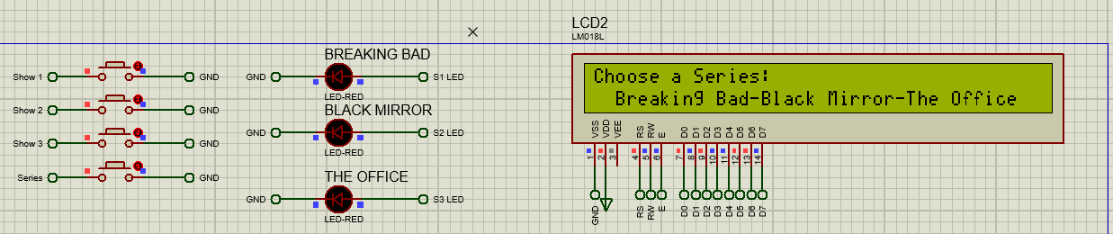
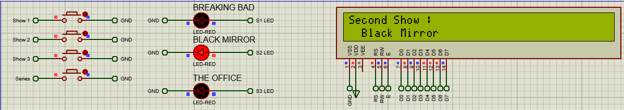
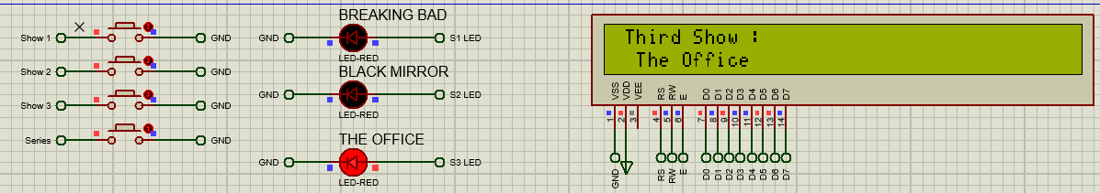
LCD-Connection
Button1
Button4
Button2
Button3

Slide 13
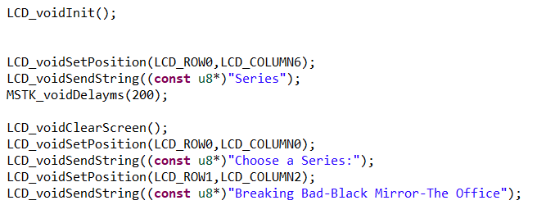
LCD-Code (main)(initialization)
initialization
Send The String and set its position
Clear then Send The String and set its position

Slide 14
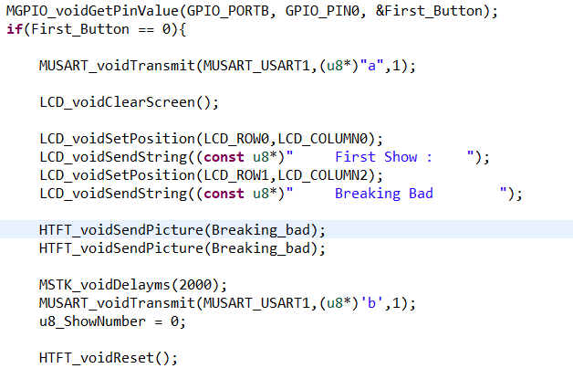
LCD-Code (main)(Show-Example)
Clear
Send The String and set its position
/*Same for other buttons*/

Slide 15
03
Buttons & Leds

Slide 16
Buttons-LEDs (Drivers)
GPIO:GPIO pins on microcontrollers serve as versatile interfaces that can be configured as either inputs or outputs. They are used to connect and communicate with various external devices, such as sensors, buttons, LEDs, and displays.
RCC: RCC is a peripheral found in many microcontrollers, responsible for controlling the clock system. It manages clock sources, clock distribution, and clock gating for various peripherals and the CPU.
USART :USART is a versatile communication peripheral found in microcontrollers, enabling serial communication with external devices such as sensors, GPS modules, and other microcontrollers. USART supports both synchronous and asynchronous serial communication protocols.

Slide 17
Buttons-LEDs
Usage of the Buttons and LEDs Screen:
- It introduces a synchronized display system utilizing USART communication to control LCD, LED Matrix, and TFT display components simultaneously.
- The system enables users to trigger the display of predefined content by pressing one of four buttons, with the selected content appearing on the LED Matrix and corresponding images transmitted to the TFT display.
- Key components include a microcontroller unit (MCU) with USART modules, LCD, LED Matrix, TFT displays, and user input buttons.

Slide 18
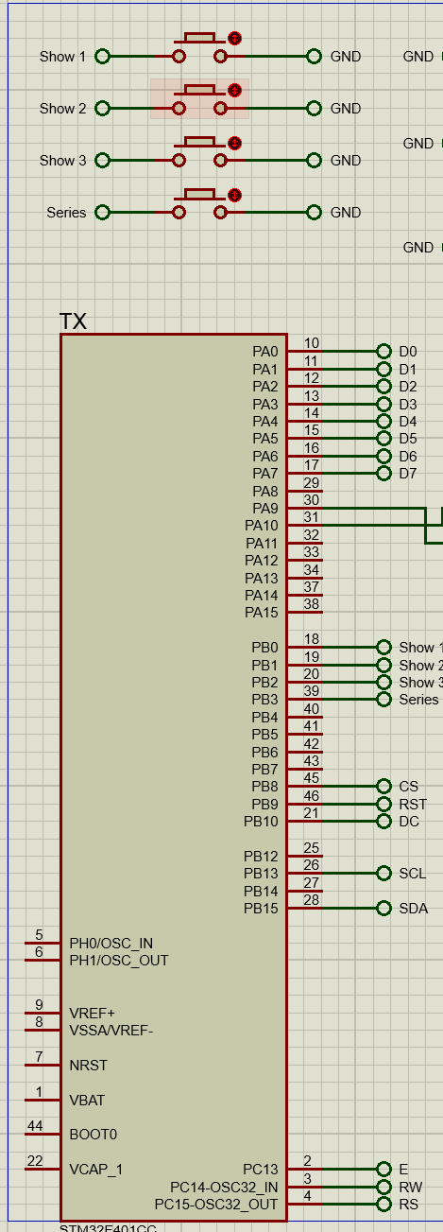
Buttons-LEDs (Connection)
4 Buttons : They are connected to the Tx microcontroller's Port B. Pressing the first button triggers the display of predefined content on the LCD, LED Matrix, and TFT displays simultaneously. This functionality facilitates user interaction and seamless content presentation across all components.

Slide 19
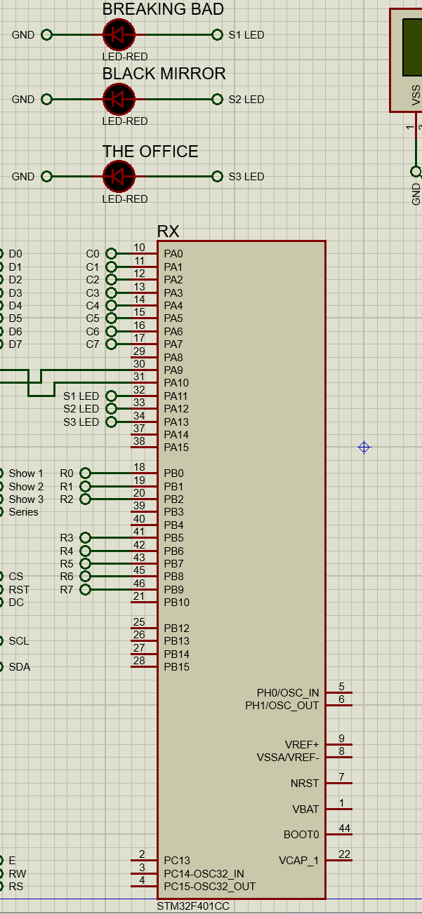
Buttons-LEDs (Connection)
3 LEDS: Three LEDs are integrated into the system, connected to the Rx microcontroller's Port A. Each LED illuminates in response to button presses from the four buttons available, indicating user interaction and providing visual feedback within the system.

Slide 20
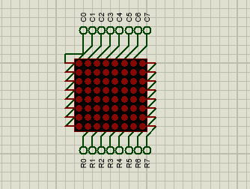
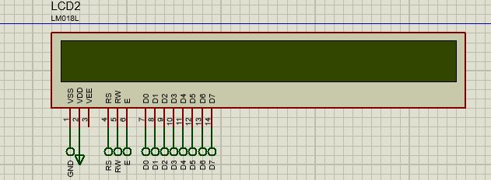
Buttons-LEDs (Connection)
LCD: as mentioned before Port A, Pins 0 to 7 are used for connecting the data lines of the LCD module
LED Matrix: Upon pressing the designated button, the LED Matrix component within the system displays the selected show.

Slide 21
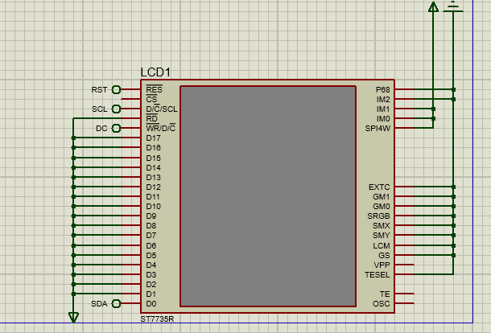
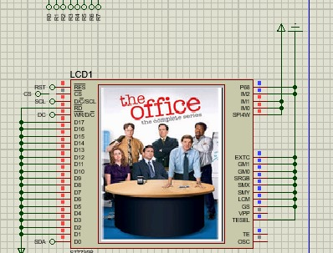
Buttons-LEDs (Connection)
TFT: Upon pressing any of the four buttons, the system concurrently displays the selected show on the LCD and LED Matrix components.
Additionally, it transmits the corresponding picture of the chosen show to the TFT screen.
This synchronized operation ensures seamless user interaction and consistent content presentation across all display components. how on the screen of the tft.

Slide 22
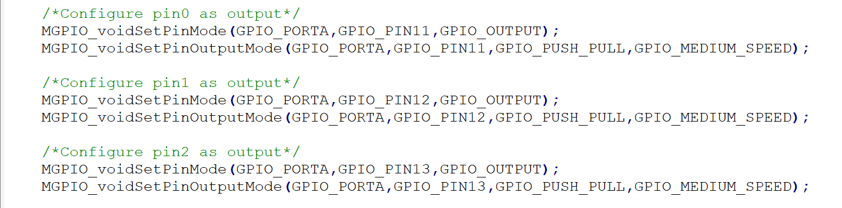
Buttons-LEDs (Code)
This code configures three pins (PIN0 (GPIO_PIN11), PIN1 (GPIO_PIN12), PIN2 (GPIO_PIN13)) of GPIO port A as output pins for leds

Slide 23
Buttons-LEDs (Code)
1-Pin0 (GPIO_PIN11): It's configured as an output pin using the functions MGPIO_voidSetPinMode() and MGPIO_voidSetPinOutputMode(). This pin will be set to drive output signals. The configuration specifies GPIO_PUSH_PULL mode. Additionally, it's set to operate at GPIO_MEDIUM_SPEED.
2-Pin1 (GPIO_PIN12): Similar to pin0, pin1 is configured as an output pin on GPIO port A. It's set to operate in GPIO_PUSH_PULL mode with GPIO_MEDIUM_SPEED.
3-Pin2 (GPIO_PIN13): Again, like pin0 and pin1, pin2 is configured as an output pin on GPIO port A. It operates in GPIO_PUSH_PULL mode at GPIO_MEDIUM_SPEED.

Slide 24
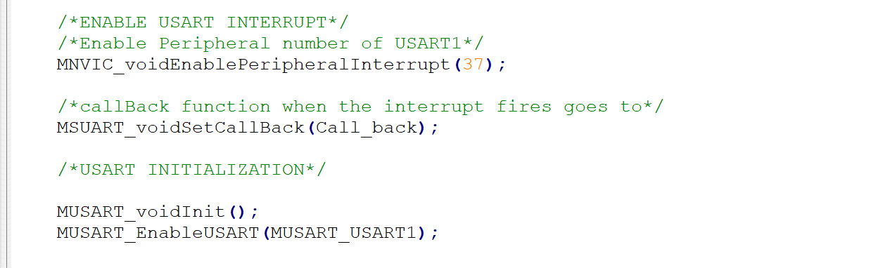
Buttons-LEDs (Code)
- Activates the USART1 peripheral by enabling its interrupt.
- This sets up a callback function named "Call_back" to be executed when the USART1 interrupt fires
-Initializes the USART1 module with default settings
-Enables the USART1 module after initialization.

Slide 25
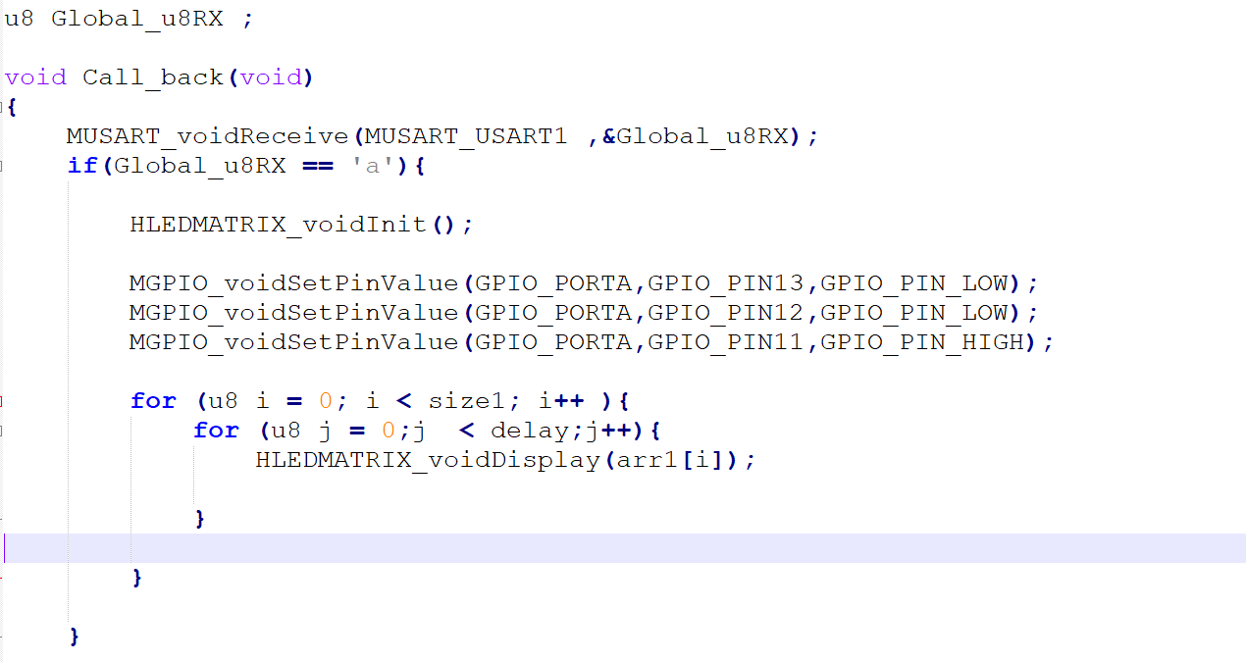
Buttons-LEDs (Code)
-Defines a callback function named Call_back, which is executed upon receiving data via USART1.
-The callback function receives data from USART1 using MUSART_voidReceive() and stores it in Global_u8RX
-global variable used to store the received data from USART1.
-The LED Matrix is initialized
-GPIO pins on Port A are configured to control the LED Matrix display.
-Upon receiving 'a' through USART1, the LED Matrix is initialized and displays a specific pattern, enhancing user interaction and visual feedback.

Slide 26
04
LED-MATRIX

Slide 27
LED-MATRIX(Drivers)
GPIO:GPIO pins on microcontrollers serve as versatile interfaces that can be configured as either inputs or outputs. They are used to connect and communicate with various external devices, such as sensors, buttons, LEDs, and displays.
RCC: RCC is a peripheral found in many microcontrollers, responsible for controlling the clock system. It manages clock sources, clock distribution, and clock gating for various peripherals and the CPU.
STK :The clock signal is essential for synchronizing the operations of the microcontroller and its peripherals. It provides timing information for various tasks, including data processing, communication, and peripheral control.
LEDMATRIX: An LED matrix driver is a hardware component or software module used to control LED matrices, which are arrays of LEDs arranged in rows and columns. LED matrices are commonly used for displaying text, graphics, and animations in various applications, including signs, displays, and decorative lighting.

Slide 28
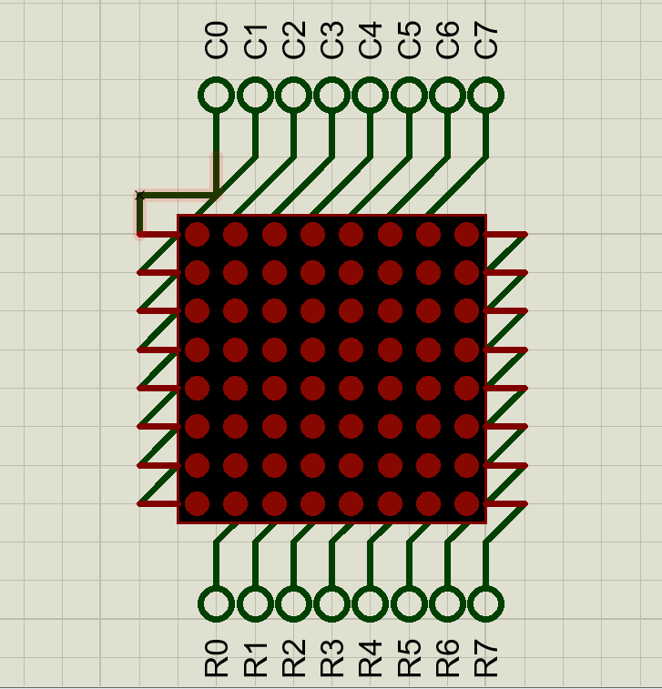
LED-MATRIX
Number of leds=8*8
Screen refresh (persistance of vision)=40:60
Frame=8*50=400fps
Time delay =1/400fps=2.5msec=2500usec

Slide 29
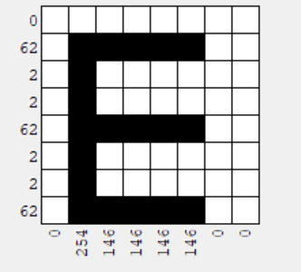
LED-MATRIX(Arrays)
1- Use LED Matrix Studio to get the desired characters, and take the array values form it for given char like (E)
2- Instead of doing the combinations of the all the chars manually, a python script was built to doing all the shifting by taking only the chars of the desired string and give us the whole array of the chars.

Slide 30
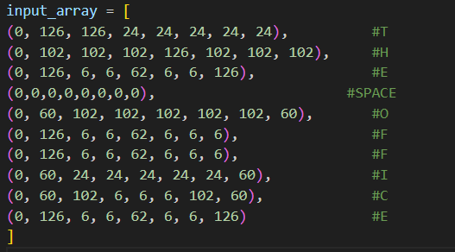
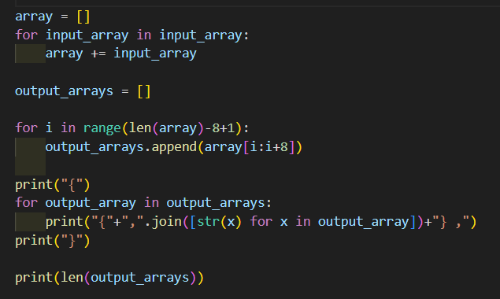
LED-MATRIX(Python-Script)

Slide 31
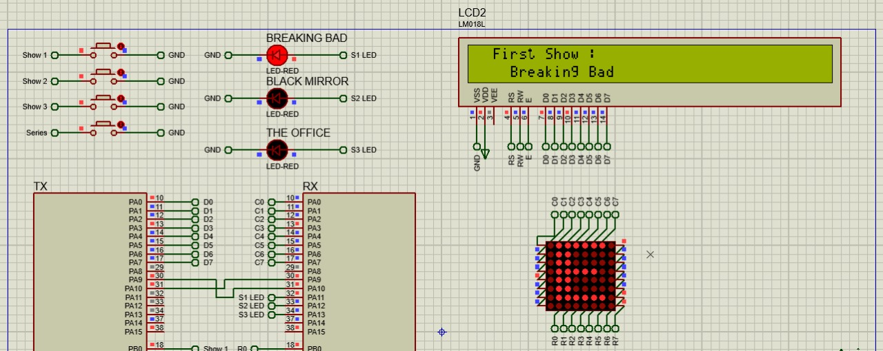
LED-MATRIX(Display)
After button is clicked the array of String been sent to LED MATRIX From RX by using the display function in LED-MATRIX driver, frames are changing smoothly to achieve the display of the whole word.

Slide 32
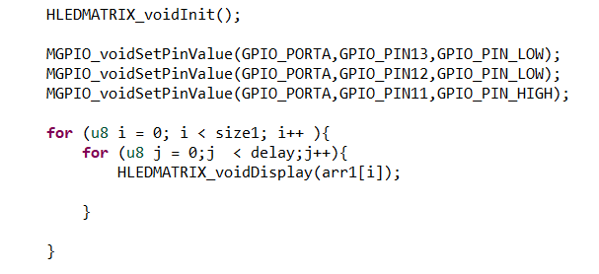
LED-MATRIX(Display)
Initialization
(set pins for leds)
Loop over the array of the arrays and display it sequentially using
HLEDMATRIX_voidDisplay(ARR)

Slide 33
05
TFT

Slide 34
TFT
TFT (Thin Film Transistor) is a type of LCD that uses in controling individual pixels on the screen. These transistors are integrated directly onto the glass substrate of the display panel. TFT technology improve image quality, and enables higher resolution.
Usage of TFT:
Image Resize: First, determine the resolution of the TFT display in terms of width and height, and calculate the scaling factors, then decide which method to use for resizing the image.
Convert image to Array: After loading the image and choosing the color format, we convert the image to the desired format with the TFT display, storing these pixels in an array, then transfer the array to the TFT using SPI driver.

Slide 35
TFT-Drivers
GPIO:GPIO pins on microcontrollers serve as versatile interfaces that can be configured as either inputs or outputs. They are used to connect and communicate with various external devices, such as sensors, buttons, LEDs, and displays.
STK :The clock signal is essential for synchronizing the operations of the microcontroller and its peripherals. It provides timing information for various tasks, including data processing, communication, and peripheral control.
RCC: RCC is a peripheral found in many microcontrollers, responsible for controlling the clock system. It manages clock sources, clock distribution, and clock gating for various peripherals and the CPU.
SPI: SPI is a synchronous serial communication interface commonly used for short-distance communication between microcontrollers and peripheral devices such as sensors, displays, and memory chips.
TFT:TFT displays use a matrix of thin-film transistors to control individual pixels on the screen. Each pixel consists of red, green, and blue subpixels, allowing for full-color displays. TFT displays offer high resolution, fast response times, and excellent color reproduction..

Slide 36
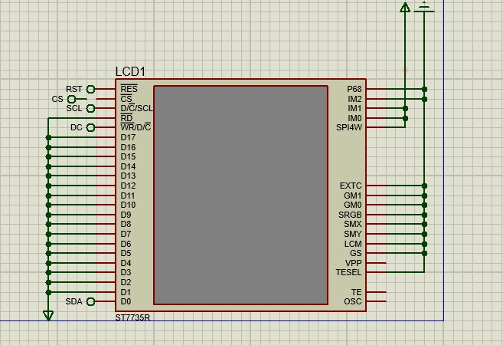
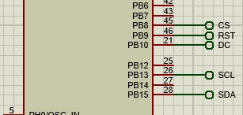
TFT-connection
TFT Data Lines:
Port B, Pins 9,8,10 are used for connecting the data lines of the TFT module. These pins communication between the TX and the TFT , allowing for sending the image and display on the TFT.

Slide 37
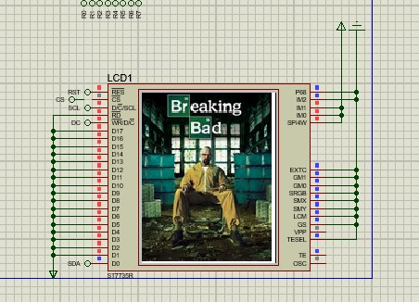
TFT-Connection
When clicking on button 1,2 images will display on TFT

Slide 38
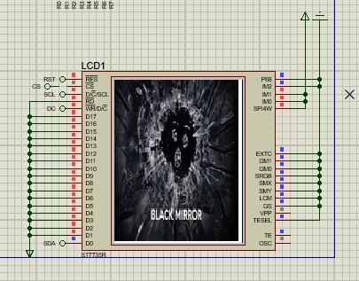
TFT-Connection
Button 3

Slide 39
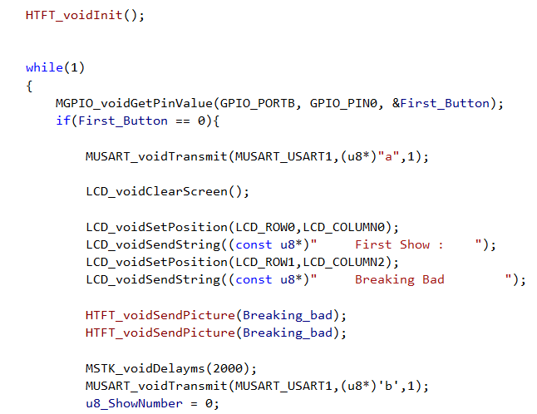
TFT-Code (main) (initialization)
initializes the TFT display, initializes SPI, and sends initialization commands to set up the display parameters.
checks the state of a button connected to GPIO port B, pin 0 using ‘MGPIO_voidGetPinValue()’ function.

Slide 40
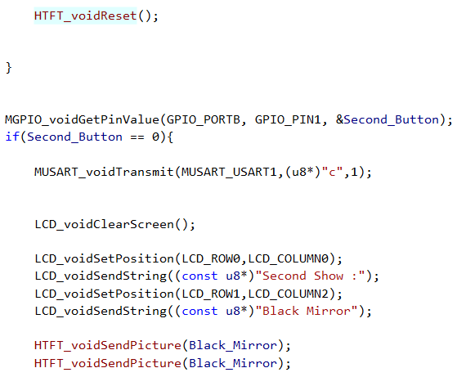
TFT-Code (main) (initialization)
checks the state of a second button connected to GPIO port B, pin 1,
transmit the character 'c' via USART1 using ‘MUSART_voidTransmit()’ function.

Slide 41
Thanks!
Do you have any questions?
Mohamed Omar
Arwaa Ashraf
Shahd Haitham Elghazaly
Shahd Samy Mohamed
Please keep this slide for attribution

